Slide 1
INTRODUCTION
.
Computer Science and Engineering, VJCET, Vazhakulam

Slide 2
SOFT COMPUTING (SC)
Soft Computing (SC): The symbiotic use of many emerging problem-solving disciplines.
According to Prof. Zadeh:
  "...in contrast to traditional hard computing, soft computing exploits the tolerance for imprecision, uncertainty, and partial truth to achieve tractability, robustness, low solution-cost, and better rapport with reality”
  Soft Computing Main Components:
  Approximate Reasoning
  Search & Optimization
    Neural Networks, Fuzzy Logic, Evolutionary Algorithms
Computer Science and Engineering, VJCET, Vazhakulam

Slide 3
Why is this important?
The information revolution going on is allowing us to automate information processing tasks which require intelligence much like the industrial revolution automated manufacturing tasks
“Soft Computing” techniques have already been applied successfully.
Farming
corn & cows
Industrial
Revolution
Manufacturing
chairs & cars
Information
Revolution
Service
content and code
Computer Science and Engineering, VJCET, Vazhakulam

Slide 4
COURSE OBJECTIVE
To introduce the concepts in Soft Computing such as Artificial Neural Networks, Fuzzy logic based systems, genetic algorithm-based systems and their hybrids.
Computer Science and Engineering, VJCET, Vazhakulam

Slide 5
SYLLABUS
MODULE 1
  Introduction to Soft Computing
  Artificial neural networks - biological neurons
  Basic models of artificial neural networks
    Connections,
    Learning,
    Activation Functions,
  McCulloch and Pitts Neuron
  Hebb network.
MODULE 2
  Perceptron networks–Learning rule, Training and testing algorithm,
  Adaptive Linear Neuron - Architecture, Training algorithm
  Back propagation Network – Architecture, Training algorithm
Computer Science and Engineering, VJCET, Vazhakulam

Slide 6
MODULE 3
  Fuzzy logic - fuzzy sets - properties - operations on fuzzy sets
  fuzzy relations - operations on fuzzy relations
MODULE 4
  Fuzzy membership functions, fuzzification, Methods of membership value assignments – intuition – inference – rank ordering, Lambda –cuts for fuzzy sets, Defuzzification methods
MODULE 5
  Truth values and Tables in Fuzzy Logic
  Fuzzy propositions,
  Formation of fuzzy rules
    Decomposition of rules
    Aggregation of rules,
  Fuzzy Inference Systems – Mamdani and Sugeno types,
  Neuro-fuzzy hybrid systems – characteristics - classification
Computer Science and Engineering, VJCET, Vazhakulam

Slide 7
MODULE 6
  Introduction to genetic algorithm,
  operators in genetic algorithm
      coding
      selection
      cross over
      mutation,
  Stopping condition for genetic algorithm flow,
  Genetic neuro hybrid systems,
  Genetic-Fuzzy rule based system
Computer Science and Engineering, VJCET, Vazhakulam

Slide 8
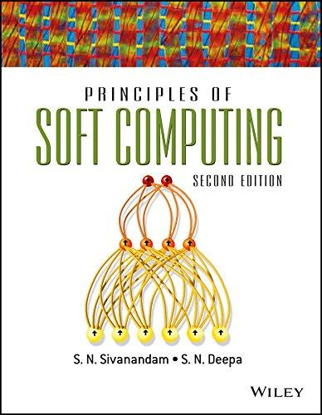

BOOKS REFFERED
Computer Science and Engineering, VJCET, Vazhakulam

Slide 9
REFERENCES
N. K. Sinha and M. M. Gupta, Soft Computing & Intelligent Systems: Theory & Applications-Academic Press /Elsevier. 2009.
Simon Haykin, Neural Network- A Comprehensive Foundation- Prentice Hall International, Inc.
R. Eberhart and Y. Shi, Computational Intelligence: Concepts to Implementation, Morgan Kaufman/Elsevier, 2007.
Ross T.J. , Fuzzy Logic with Engineering Applications- McGraw Hill.
Driankov D., Hellendoorn H. and Reinfrank M., An Introduction to Fuzzy Control- Narosa Pub.
Bart Kosko, Neural Network and Fuzzy Systems- Prentice Hall, Inc., Englewood Cliffs
Goldberg D.E., Genetic Algorithms in Search, Optimization, and Machine Learning
Computer Science and Engineering, VJCET, Vazhakulam

Slide 10
COURSE OUTCOME
Learn about soft computing techniques and their applications.
Analyze various neural network architectures.
Define the fuzzy systems
Define various hybrid systems
Understand the genetic algorithm concepts and their applications.
Identify and select a suitable Soft Computing technology to solve the problem
Computer Science and Engineering, VJCET, Vazhakulam

Slide 11
What is computing?
Counting, calculating
The discipline of computing is the systematic study of algorithmic processes that describe and transform information: their theory, analysis, design, efficiency, implementation, and application.
Types of computing
  Hard computing
  Soft Computing
Computer Science and Engineering, VJCET, Vazhakulam

Slide 12
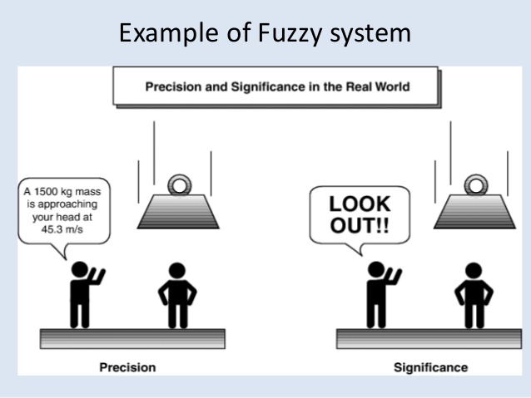
Computer Science and Engineering, VJCET, Vazhakulam

Slide 13
PROBLEM SOLVING TECHNIQUES
HARD COMPUTING
SOFT COMPUTING
Precise Models
Approximate Models
Traditional Numerical
Modeling and Search
Functional
Approximation
and Randomized
Search
Symbolic
Logic
Reasoning
Approximate
Reasoning
Computer Science and Engineering, VJCET, Vazhakulam

Slide 14
What is SC?
The term soft computing was proposed by the inventor of fuzzy logic, Lotfi A. Zadeh. He describes it as follows [Zadeh, 1994]:
“Soft computing is a collection of methodologies that aim to exploit the tolerance for imprecision and uncertainty to achieve tractability, robustness, and low solution cost.
Its principal constituents are fuzzy logic, neurocomputing, and probabilistic reasoning.
Soft computing is likely to play an increasingly important role in many application areas, including software engineering.
The role model for soft computing is the human mind.”
[Zadeh, 1994]
Computer Science and Engineering, VJCET, Vazhakulam

Slide 15

Soft Computing
“The essence of soft computing is that unlike the traditional, hard computing, soft computing is aimed at an accommodation with the pervasive imprecision of the real world. Thus, the guiding principle of soft computing is to exploit the tolerance for imprecision, uncertainty, and partial truth to achieve tractability, robustness, low solution cost, and better rapport with reality”
- Lotfi Zadeh
Computer Science and Engineering, VJCET, Vazhakulam

Slide 16
Differences between hard and soft computing
Hard Computing | Soft computing
Precisely stated analytical model | Tolerant to imprecision, uncertainty, partial truth, approximation
Based on binary logic, crisp systems, numerical analysis, crisp software | Fuzzy logic, neural nets, probabilistic reasoning.
Programs are to be written | Evolve their own programs
Two values logic | Multi valued logic
Exact input data | Ambiguous and noisy data
Strictly sequential | Parallel computations
Precise answers | Approximate answers
Computer Science and Engineering, VJCET, Vazhakulam

Slide 17
Artificial intelligence
If intelligence can be induced in machines it is called as artificial intelligence.
Soft computing is a part of artificial intelligent techniques
Closed related to machine intelligence / computational intelligence
Computer Science and Engineering, VJCET, Vazhakulam

Slide 18
OVERVIEW OF TECHNIQUES IN SOFT COMPUTING
  Neural Networks
  Fuzzy Logic
  Genetic Algorithm
  Hybrid Systems
Computer Science and Engineering, VJCET, Vazhakulam

Slide 19
What is Soft computing
Neural Networks
Neuro-
Fuzzy
Computing
Derivative-
Free
Optimization
Soft Computing
+
=
Fuzzy Inference
systems
Computer Science and Engineering, VJCET, Vazhakulam

Slide 20
Artificial Neural Networks
Fuzzy logic
Soft Computing
Evolutionary computation
Heuristics
Computer Science and Engineering, VJCET, Vazhakulam

Slide 21
Current Applications using Soft Computing
Handwriting recognition
Automotive systems and manufacturing
Image processing and data compression
Architecture
Decision-support systems
Data Mining
Power systems
Control Systems
Computer Science and Engineering, VJCET, Vazhakulam

Slide 22
Latest developments in the field of soft computing
Areas of image processing
  Image retrieval
  Image analysis
Remote sensing
Data mining
  Swarm intelligence
  Diffusion process
  Agent’s technology
Computer Science and Engineering, VJCET, Vazhakulam

Slide 23
NEURAL NETWORKS
DARPA Neural Network Study (1988, AFCEA International Press, p. 60):
... a neural network is a system composed of many simple processing elements operating in parallel whose function is determined by network structure, connection strengths, and the processing performed at computing elements or nodes.
Computer Science and Engineering, VJCET, Vazhakulam

Slide 24
AI and Soft Computing
cat
Animal?
cat
cut
Neural character
recognition
knowledge
Computer Science and Engineering, VJCET, Vazhakulam

Slide 25
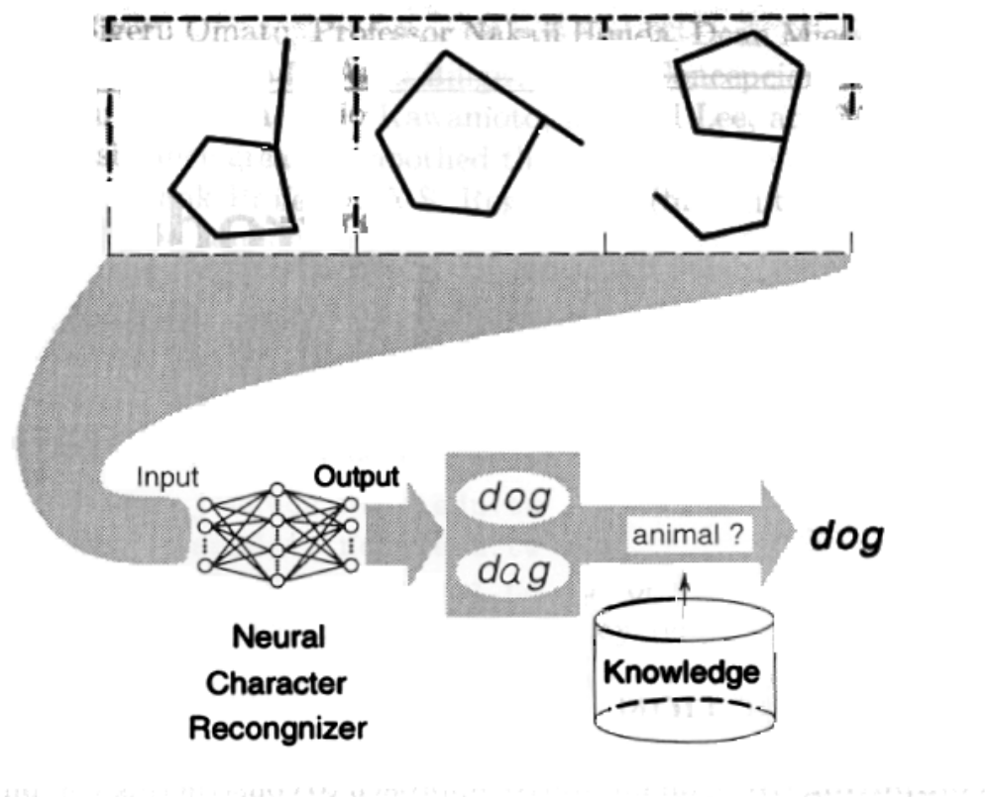
character recognizer
Computer Science and Engineering, VJCET, Vazhakulam

Slide 26
DEFINITIONS OF NEURAL NETWORKS
According to Haykin (1994), p. 2:
A neural network is a massively parallel distributed processor that has a natural propensity for storing experiential knowledge and making it available for use. It resembles the brain in two respects:
Knowledge is acquired by the network through a learning process.
Interneuron connection strengths known as synaptic weights are used to store the knowledge
Computer Science and Engineering, VJCET, Vazhakulam

Slide 27
According to Nigrin (1993), p. 11:
A neural network is a circuit composed of a very large number of simple processing elements that are neurally based. Each element operates only on local information.
Furthermore each element operates asynchronously; thus there is no overall system clock.
According to Zurada (1992):
Artificial neural systems, or neural networks, are physical cellular systems which can acquire, store and utilize experiential knowledge.
Computer Science and Engineering, VJCET, Vazhakulam

Slide 28
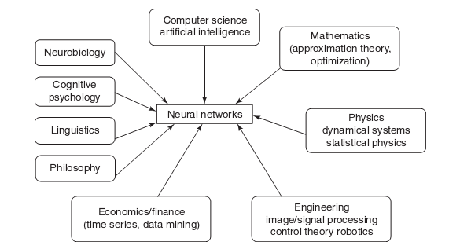
MULTIDISCIPLINARY VIEW OF NEURAL NETWORKS
Computer Science and Engineering, VJCET, Vazhakulam

Slide 29
FUZZY LOGIC
Origins: Multivalued Logic for treatment of imprecision and vagueness
  1930s: Post, Kleene, and Lukasiewicz attempted to represent undetermined, unknown, and other possible intermediate truth-values.
  1937: Max Black suggested the use of a consistency profile to represent vague (ambiguous) concepts.
  1965: Zadeh proposed a complete theory of fuzzy sets (and its isomorphic fuzzy logic), to represent and manipulate ill-defined concepts.
Computer Science and Engineering, VJCET, Vazhakulam

Slide 30
FUZZY LOGIC – LINGUISTIC VARIABLES
  Fuzzy logic gives us a language (with syntax and local semantics) in which we can translate our qualitative domain knowledge.
  Linguistic variables to model dynamic systems
  These variables take linguistic values that are characterized by:
  a label - a sentence generated from the syntax
  a meaning - a membership function determined by a local semantic procedure
Computer Science and Engineering, VJCET, Vazhakulam

Slide 31
FUZZY LOGIC – REASONING METHODS
  The meaning of a linguistic variable may be interpreted as an elastic constraint on its value.
  These constraints are propagated by fuzzy inference operations, based on the generalized modus-ponens.
  An FL Controller (FLC) applies this reasoning system to a Knowledge Base (KB) containing the problem domain heuristics.
  The inference is the result of interpolating among the outputs of all relevant rules.
  The outcome is a membership distribution on the output space, which is defuzzified to produce a crisp output.
Computer Science and Engineering, VJCET, Vazhakulam

Slide 32

GENETIC ALGORITHM
EVOLUTIONARY PROCESS
Computer Science and Engineering, VJCET, Vazhakulam

Slide 33
DEFINITION OF GENETIC ALGORITHM
  The genetic algorithm is a probabalistic search algorithm that iteratively transforms a set (called a population) of mathematical objects (typically fixed-length binary character strings), each with an associated fitness value, into a new population of offspring objects using the Darwinian principle of natural selection and using operations that are patterned after naturally occurring genetic operations, such as crossover (sexual recombination) and mutation.
Computer Science and Engineering, VJCET, Vazhakulam

Slide 34
STEPS INVOLVED IN GENETIC ALGORITHM
The genetic algorithms follow the evolution process in the nature to find the better solutions of some complicated problems. Foundations of genetic algorithms are given in Holland (1975) and Goldberg (1989) books.
Genetic algorithms consist the following steps:
Initialization
Selection
Reproduction with crossover and mutation
Selection and reproduction are repeated for each generation until a solution is reached.
During this procedure a certain strings of symbols, known as chromosomes, evaluate toward better solution.
Computer Science and Engineering, VJCET, Vazhakulam

Slide 35
HYBRID SYSTEMS
Hybrid systems enables one to combine various soft computing paradigms and result in a best solution. The major three hybrid systems are as follows:
  Hybrid Fuzzy Logic (FL) Systems
  Hybrid Neural Network (NN) Systems
  Hybrid Evolutionary Algorithm (EA) Systems
Computer Science and Engineering, VJCET, Vazhakulam

Slide 36
SOFT COMPUTING: HYBRID FL SYSTEMS
Approximate Reasoning
Functional Approximation/ Randomized Search
Probabilistic
Models
Multivalued &
Fuzzy Logics
Neural
Networks
Evolutionary
Algorithms
Fuzzy
Systems
Multivalued
Algebras
Fuzzy Logic
Controllers
HYBRID FL SYSTEMS
NN modified by FS
(Fuzzy Neural
Systems)
FLC Tuned by NN
(Neural Fuzzy
Systems)
FLC Generated
and Tuned by EA
Computer Science and Engineering, VJCET, Vazhakulam

Slide 37
SOFT COMPUTING: HYBRID NN SYSTEMS
Approximate Reasoning
Functional Approximation/ Randomized Search
Probabilistic
Models
Multivalued &
Fuzzy Logics
Neural
Networks
Evolutionary
Algorithms
Feedforward
NN
Recurrent
NN
RBF
Single/Multiple
Layer Perceptron
Hopfield
SOM
ART
HYBRID NN SYSTEMS
NN parameters
(learning rate h
momentum a )
NN topology and/or
weights
controlled by FLC
generated by EAs
Computer Science and Engineering, VJCET, Vazhakulam

Slide 38
SOFT COMPUTING: HYBRID EA SYSTEMS
Approximate Reasoning
Functional Approximation/ Randomized Search
Probabilistic
Models
Multivalued &
Fuzzy Logics
Neural
Networks
Evolutionary
Algorithms
Evolution
Genetic
Strategies
Algorithms
Evolutionary
Genetic
Programs
Programs
HYBRID EA SYSTEMS
EA parameters
EA-based search
EA parameters
(N, P
, P
)
inter-twined with
(Pop size, selection)
cr
mu
controlled by FLC
hill-climbing
controlled by EA
Computer Science and Engineering, VJCET, Vazhakulam

Slide 39
APPLICATIONS OF SOFT COMPUTING
Handwriting Recognition
Image Processing and Data Compression
Automotive Systems and Manufacturing
Soft Computing to Architecture
Decision-support Systems
Soft Computing to Power Systems
Neuro Fuzzy systems
Fuzzy Logic Control
Machine Learning Applications
Speech and Vision Recognition Systems
Process Control and So on
Computer Science and Engineering, VJCET, Vazhakulam

